Slide 1
IR35
New legislation being introduced to the
Private Sector on 6th April 2021 for
medium & large sized companies

Slide 2
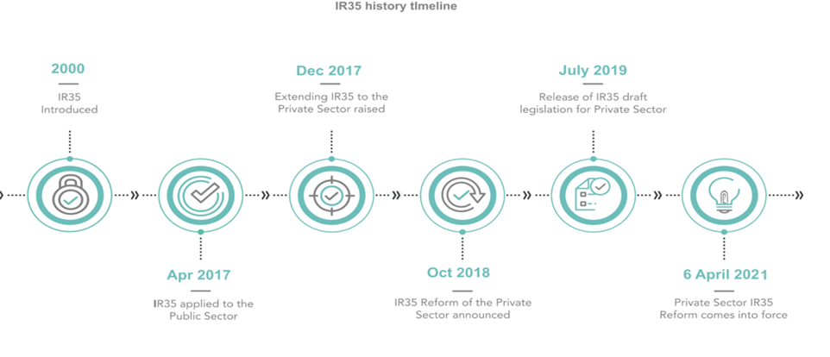
What is IR35?
Introduced in 1999, the IR35 legislation (also known as the Intermediaries Legislation), became law through the Finance Act in 2000.
The diagram above provides a timeline of when IR35’s introduction to both the Public and private sectors and when they come into effect:
Public sector – April 2017
Private Sector – April 2021

Slide 3
What is IR35?
On the 22nd July 2020 - The Finance Act 2020, which contains the legislative changes impacting IR35 in the private sector effective from 6 April 2021, receives Royal Assent and becomes law.
IR35 refers to the United Kingdom's anti-avoidance tax legislation designed to tax disguised employment at a rate similar to employment. In this context, "disguised employees" means workers who receive payments from a client via an intermediary, for example, their own limited company, and whose relationship with their client is such that had they been paid directly they would be employees of the client.
Before IR35 was introduced, workers who owned their own limited companies were allowed to receive payments from clients direct to the company and to use the company revenue as would any small company.
Company profits could be distributed as dividends, which are not subject to National Insurance payments. Workers could also save tax by splitting ownership of the company with family members in order to place income in lower tax bands.

Slide 4
What is IR35?
Under the changes from April 2021, responsibility for undertaking employment status assessments will become the responsibility of the entity using the services of the worker, whilst the responsibility for operating PAYE withholding will be that of the entity paying the personal service companies (PSC).
The legislation also introduces the concept of a “Status Determination Statement” or “SDS”, which end users will be required to provide directly to the worker. The SDS must include not only the decision of the worker’s “deemed” employment status, but also the rationale for reaching this conclusion.

Slide 5
NEW IR35 RULES – why are you not affected?
“SMALL” private sector companies EXEMPT
The IR35 does not apply to employment businesses that are classed as “small” organisations. They will therefore not be affected by the reform and will not need to determine the status of the contractors they engage. An organisation is considered small if two or more of the following conditions are met, as per the Companies Act 2006:
A small company is defined as such which satisfies two or more of the following requirements:
1. has an aggregate turnover less than £10.2million 2. has an aggregate balance sheet total less than £6.1million 3. has less than 50 employees
https://www.gov.uk/guidance/april-2020-changes-to-off-payroll-working-for-clients

Slide 6
What does it mean for medium and large sized private sector companies?
Medium and large sized private sector businesses hiring personal service company contractors will be responsible for determining the IR35 status of their contractors as of 6th April 2021.
Those workers who fall inside of IR35 will be required to have PAYE and National Insurance Contributions (NICs) deducted at source from their income. The 'fee-payer' (usually the agency or end client depending on the contractual chain) will be responsible for deducting the relevant tax and NICs on behalf of the worker, prior to paying the PSC's fee.
Unveiled as a policy in the UK government’s 2018 Budget, the move came as no surprise to private business, having been rolled out to public sector employers the year before.

Slide 7
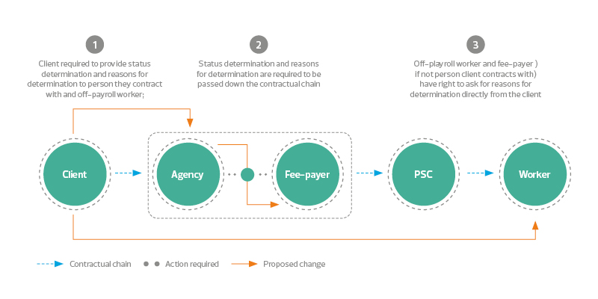
Illustration of IR35 changes

Slide 8
IR35 & Construction Industry Scheme (CIS) (within medium and large sized organisations) changes as a result of IR35
In the construction sector, organisations who engage individuals on contracts are commonly known as contractors. The individuals themselves are sub-contractors.
The off-payroll working rules apply across all sectors, and guidance uses these terms differently. An organisation who engages individuals on contracts is more commonly known as the ‘client’. The individual who supplies their services is referred to as the ‘contractor’. Supply chains may also include employment agencies, often referred to as ‘agencies’.
How does the off-payroll working reform impact individuals in the construction sector?
The organisation you provide services to will need to consider whether the off-payroll working rules apply.
This means they should:
Decide if your contract is inside or outside the off-payroll working rules – this means deciding whether you would be employed or self-employed for tax purposes for that contract if you were engaged directly by them.
Give you a Status Determination Statement setting out and explaining their decision. If they decide you are employed for tax purposes, they will stop deducting CIS payments. Instead, they, or the agency who pays your fees, will deduct Income Tax and NICs through PAYE before paying your limited company for your services.

Slide 9
IR35 & Construction Industry Scheme (CIS) continued….
The organisation you provide services to may already deduct an amount from their payment to you under the Construction Industry Scheme (CIS) and pay it to HMRC.
You can off-set this CIS deduction against your Income Tax and National Insurance Contributions (NICs) payments
or, if you work via a limited company, you can offset it against PAYE due monthly to HMRC or against any Corporation Tax due.
The off-payroll working rules potentially apply to engagement contracts within the construction sector, whether or not the nature of the services provided are wholly or partly within the Construction Industry Scheme. The off-payroll working rules need to be considered for all individuals working in construction who work through their own limited company or other intermediary, irrespective of the nature of the services provided.
If the off-payroll working rules apply, you will not be able to off-set the Income Tax and NICs deductions against tax you may pay through your own limited company, as you can with CIS deductions.
This means the overall amount of Income Tax and NICs you pay may increase. However, you will get relief on the tax paid when you withdraw the off-payroll income from your limited company or other intermediary, and you do not need to pay taxes or NICs on this income again when you withdraw it from your intermediary.
Where the off-payroll working rules apply, they take precedence over CIS. The off payroll working rules apply to each individual engagement, so it will be possible for off-payroll to apply to one engagement and CIS to apply to another.

Slide 10
IR35 & Construction Industry Scheme (CIS) continued….
If you supply services to the public sector, these rules already apply.
If you supply services to a small non-public sector organisation your limited company or other intermediary will remain responsible for determining if the off-payroll working rules apply.
In order to qualify for statutory payments (such as Statutory Maternity, Paternity, Adoption, Parental, Bereavement and Shared Parental Pay) from your employment with your own limited company or other intermediary, you must continue to pay yourself a salary from your own limited company. The normal qualifying conditions for eligibility for statutory payments will apply (including the requisite earnings levels).
You should not deregister for CIS if it would be useful to remain registered for future contracts.

Slide 11
How does the off-payroll working reform impact clients in the construction sector?
You will need to consider whether the off-payroll working rules apply. It means you should:
Decide if the contract is inside or outside the off-payroll working rules - meaning you need to decide if they would be employed or self-employed for tax purposes for that contract if you engaged them directly. HMRC have a free digital tool called Check Employment Status for Tax (CEST) which you may wish to use to help you.
Provide a Status Determination Statement to the individual setting out and explaining your decision, and to any agency you engage with. If the determination is ‘employed for tax purposes,’ you should stop deducting Construction Industry Scheme (CIS) payments and you, or the agency who pays the individuals limited company’s fees, will need to deduct Income Tax and National Insurance Contributions (NICs) before paying the individual’s limited company for their services as you would if you were paying an employee.
How does the off-payroll working reform impact employment agencies in the construction sector?
If you supply individuals who work through their own limited company or other intermediary, then you will have some responsibilities under the changes to the off payroll working rules.
If the client the individuals are working for determines that the off-payroll working rules apply, they will be responsible for providing the individual and the agency they engage with a Status Determination Statement, setting out and explaining their decision.

Slide 12
How does the off-payroll working reform impact employment agencies in the construction sector?
Continued…
You will need to pass this onto any agency you engage with in the chain. There are two possible actions you
need to take:
1. If you pay the fees to the individual’s limited company, you will also likely be responsible for deducting Income Tax and National Insurance Contributions (NICs), and accounting for these deductions to HMRC, before paying the individual’s limited company for their services if the off-payroll working rules apply.
2. If you pay another agency, you should pass on the Status Determination Statement to that agency.
Disputes over status
Clients will need to introduce a disagreement process to allow individuals and any agencies who are responsible for making the tax and NICs deductions to raise a disagreement with a Status Determination Statement.
If a contract is found to be inside the off-payroll working rules then CIS should be stopped and Income Tax and NICs deducted while any disputes are being considered.

Slide 13
How to prepare for IR35 (medium and large sized companies)
To show that there is no employment relationship, the contractor has to prove certain relationship criteria to determine whether they are 'inside' or 'outside' IR35. As a rule of thumb, IR35 won’t apply if the contract is for the services you provide instead of employment. It’s a good idea to keep the following three things in mind when deciding if your business falls inside or outside of IR35:
Mutuality of obligation
Working as a self-employed contractor means you can work in a project-by-project basis without any obligation to continue working for that client once the contract comes to an end. Equally, private sector employers are under no obligation to continue offering the contractor contracts once the project they are working on is complete. If an employer is obliged to offer the contractor paid work and they are obliged to take it, this is an example of a contract of employment, meaning they fall within IR35. Also, if a contract states that a contractor can’t take on other clients while working for them, this also places them within IR35.
Substitution
If a contract states that the client wants a contractor, and only them, to see a job through from start to finish, then this working relationship will fall within IR35 rules. For a contract to fall outside of IR35 it should highlight that the substitute workers they put forward can complete the contract work on your behalf instead.
Supervision, direction, control
Contractors must have control over how they complete their work for a contract to fall outside of IR35. If a contract sets working patterns and the employer provides excessive input over how work is completed, then it’s likely that this will fall under employment rather than contract work. Keep in mind that if the contractor is also completing tasks for the employer in addition to the contract services they are already providing, the contract is likely to fall within IR35 too.
If the contractor passes the test, they are 'outside' of IR35 rules, and can continue to invoice then pay themselves through their own limited company. If they are deemed 'inside' IR35 and HMRC declares that it’s an employment relationship, then tax and National Insurance will be deducted from their earnings and the liability for any missing tax lies with them. (https://www.gov.uk/employment-status/selfemployed-contractor)

Slide 14
Examples of IR35 Contract Clauses
Some clauses that could possibly appear in a contract
It must be appreciated that every contract is different and relates to varying circumstances and events. The following clauses could appear in a particular
contract. No two contracts or engagements are the same. Each contract which will be drawn up will be different to reflect the specific circumstances of the engagement.
These clauses are purely for illustrative purposes only. They should only act as a guide to the sort of clauses you would expect to sometimes see in a contract where the contractor is going to work for a client via an agency.
Clauses
The contractor will make his services available from the commencement date until the finish date
The company (the agency) may end this contract at any time once they notify the contractor in writing.
Financial Risk
Financial risk is one test that HMRC will look at when determining a contractor’s IR35 status. If an individual, via his personal service company, has very little financial risk (i.e. they are reliant on the income from the employer as their main source of income, then this is not good. It leans towards an employment! As there is very little financial risk, then he is like a deemed employee! Therefore would fall inside IR35.
Using Contractors Financial Risk to Stay Outside IR35
There are 5 main ways contractors and freelancers can differentiate between themselves and permanent employees to show they are outside IR35 as regards Contractors Financial Risk. They are:-
1. Take short contracts 2. Take some fixed price work 3.Take out Indemnity Insurance 4. Use your own PC and equipment 5. Fix any problems free of charge

Slide 15
Examples of IR35 Contract Clauses continued…
No Control
The contractor will have autonomy in respect of the technical manner it uses to perform its services.
Neither the company (the agency) nor the client (the public sector body) will control, direct or supervise the manner in which the services are provided.
Substitution…
The contractor is allowed to provide a replacement to perform the services in substitution for the personnel, but any such replacement shall only be agreed by the company (the agency) if the substitute has the necessary qualifications, skills, appropriate experience and expertise.
The contractor shall choose, engage and pay the substitute.
Agreement t by the company (the agency) will not be unreasonably withheld in relation to the use of the substitute.
Mutuality of Obligations…
Neither the company (the agency) nor the client are placed under any obligation whatsoever to offer work to the contractor.
Additionally, if offered, the contractor has no obligation to accept. It can decline the work if it so wishes. For the avoidance of doubt, neither the company (the agency) nor the contractor wishes to create any mutuality of obligation between themselves.
The company is not obliged to make any payment to the contractor for fees at any time when no work is available nor performed during this agreement.

Slide 16
Examples of IR35 Contract Clauses continued…
Premises
If and when the contractor uses the client or the company’s premises, the contractor will be liable for any damage or loss it causes to the premises, except for wear and tear.
Insurance
The contractor will have, for the duration of this contract, third party public and products liability insurance for a minimum of £…………….
Training…
The company (the agency) will not be responsible for providing any relevant training to the contractor, except for a “client-specific briefing” at the company’s own discretion.
Equipment
The contractor will be responsible for providing its own equipment in order to perform the services required.
Sundry areas…
It is the responsibility of the contractor to make its own payment and arrangements relating to holidays, sickness, benefits, insurance and pension commitments for its directors and staff. Neither the company nor the client will have any obligation whatsoever in these above areas to the contractor

